Slide 1

TE3
Transforming Evaluation
Experience

Slide 2
Agenda
Introduction
Meet the team
Motivation
Solution
Tech Stack
Next Steps

Slide 3
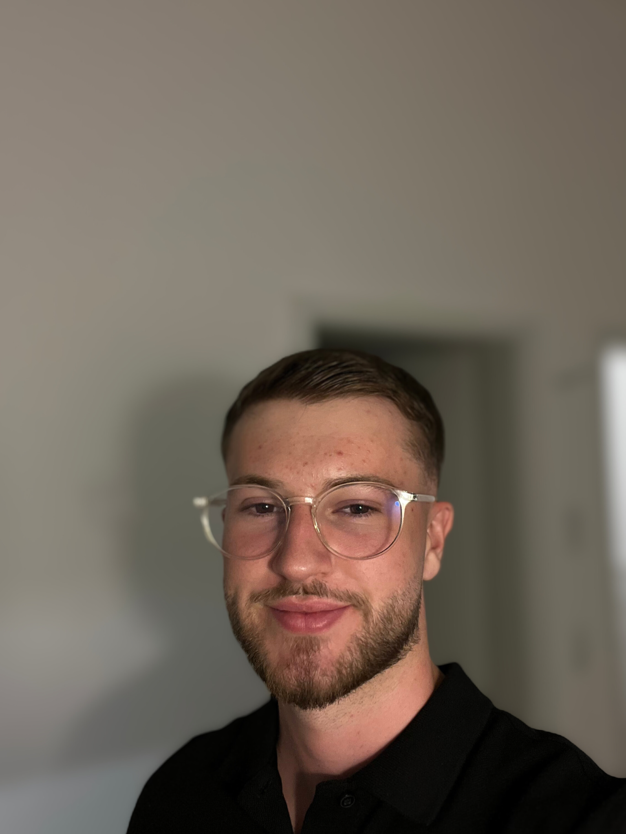
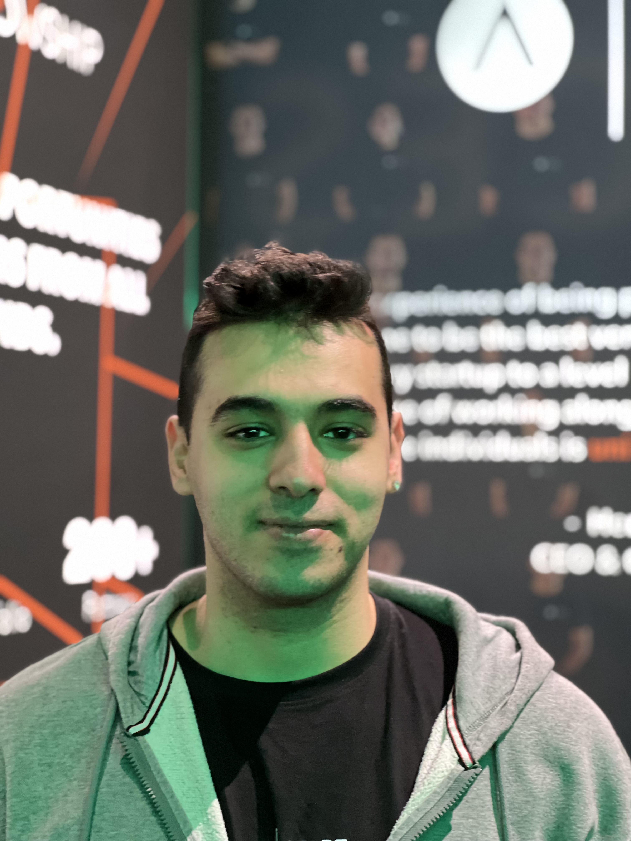

Meet the Team
Feres Essafi
Frontend Developer, Designer
Salih Uyar
Data Management
Yahia ElSaman
Frontend Developer, Product Manager

Slide 4

Motivation
Teachers overwhelmed
Educational setbacks
of COVID-19
→ Goal:
Optimize student evaluation process

Slide 5
Our Solution
Student Evaluation WebApp to assist teachers
Core emphasis on
Ease of use - Optimal user experience
Deployable and Scalable - Adapts to evolving educational needs

Slide 6



Tech Stack & Live Demo
Tailwind CSS
Vue.js
Nuxt

Slide 7
Next Steps
Use AI to personalize recommendations
Student and Parent insights
Class-based Analysis

